Slide 1
Climate Change is a Crisis of Injustice

Slide 2
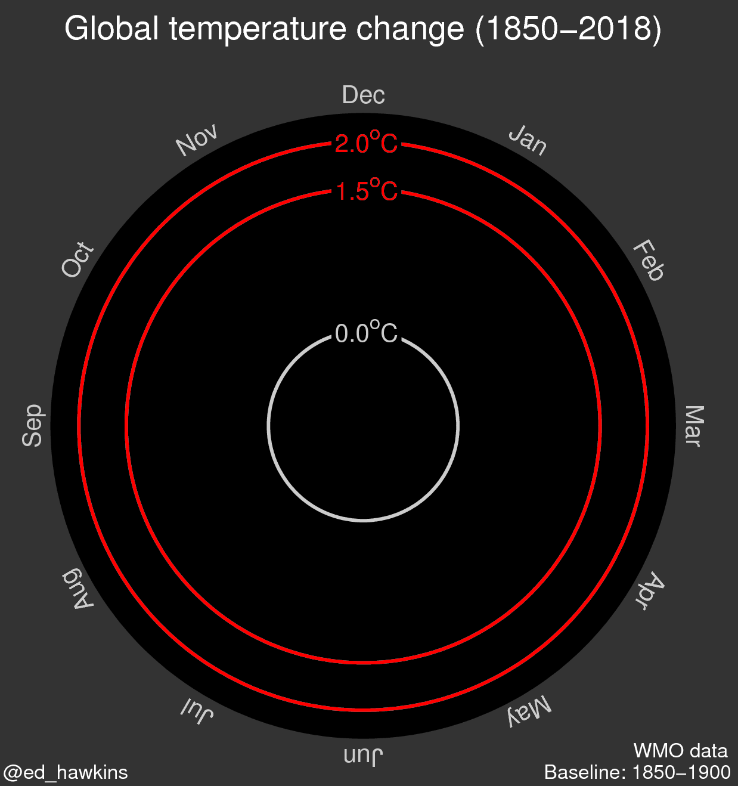
Global Temperature Change Pathway to 3.4c to 7c

Slide 3
Impacts today not tomorrow
1c warming:
Pakistan 53.5c warming
Chennai out of water
1 million on brink of starvation Mozambique
Bahamas, Dominica in ruins
Amazon burning, Arctic ice melting

Slide 4
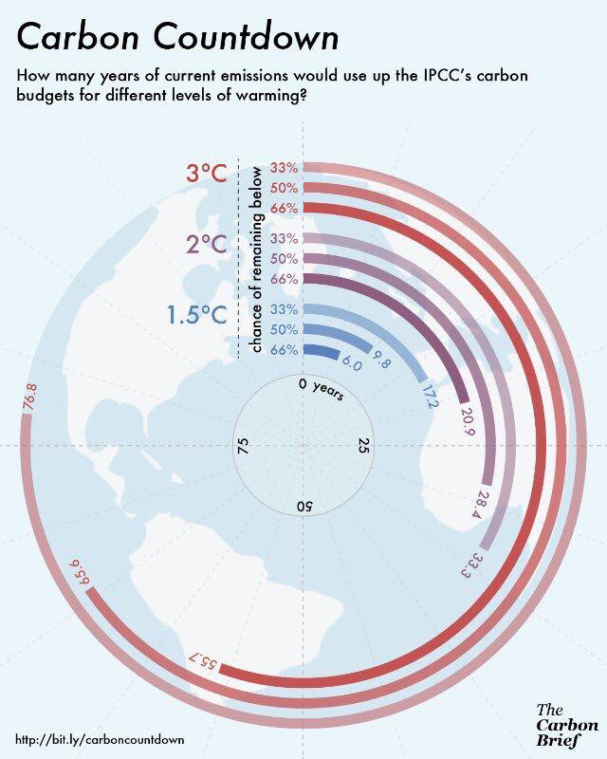
Urgency

Slide 5
Decade Zero
IPCC called for total decarbonisation by 2050
Rich countries by 2030
The IPCC 360 Gtonnes of Co2 left in the carbon budget which is about 8 1/5 years – 50/50 chance of preventing a breach of 1.5c.
If we situate ourselves on the frontlines in the global South, we would of course be saying that at best we have about 4 years left to really prevent 1.5c.

Slide 6
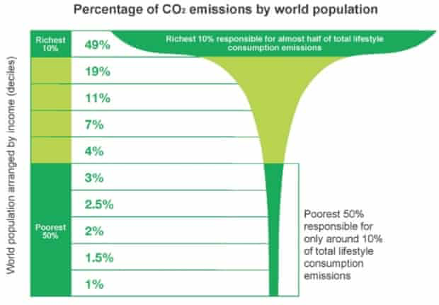
Whose responsible?

Slide 7
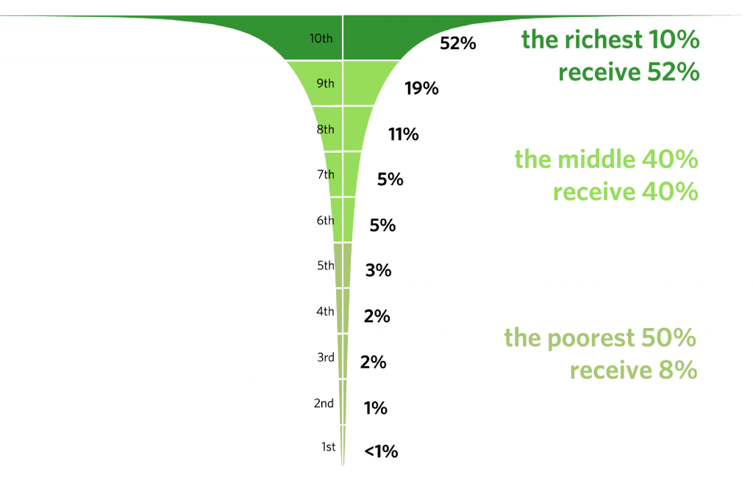
Global Poverty and Inequality

Slide 8
UK Emissions
UK 5th richest economy in the world
UK 5th most responsible for historical emissions – 5.8%
UK historical emissions per person – 2nd in world
UK consumption emissions – 5th biggest in world 11 tonnes a person

Slide 9
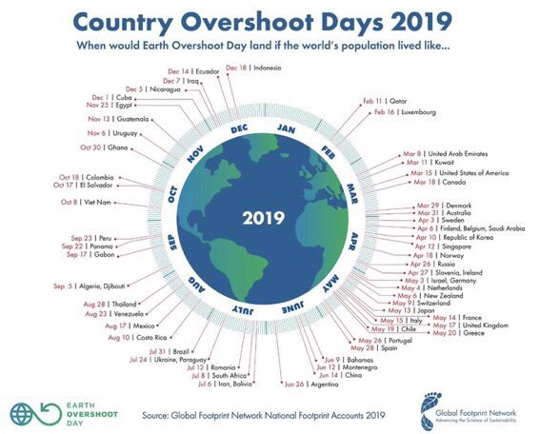
Resource Use Global Overshoot July 2019

Slide 10
Resource Use
Consumption of natural resources would rise from 70 billion metric tons per year in 2012 to 180 billion metric tons per year by 2050.
A sustainable level of resource use is about 50 billion metric tons per year.
Assume average growth – the economy expands by 55% by 2030

Slide 11
Renewable Energy – Can it save us?
Energy demand is set to increase by 40% whilst we need to reduce current energy use by 40%
Oecd – 111% increase resource extraction
150% in metals
135 in minerals
Cobalt – 423% known reserves
Lithium – 280%
Nickel – 136%

Slide 12
Oxford Fair Share
Adopt the 1.5c target and 2030 date
Support action here and globally
Champion climate justice –
Trade
Corporate Power/City of London
Energy, Food, Land, Water, Global Living Wage

Slide 13
What’s our choice?
A cleaner, fairer, safer, happier world
Versus
A world of walls and fences and billions being sacrificed

